Slide 1



Multi-drug Resistance of Pseudomonas aeruginosa Under Microgravity Growth Conditions
Edward Apraku^{1,2}, Diego Novoa¹, and Dr. Otakuye Conroy-Ben^{1,2}
¹Arizona State University, School of Sustainable Engineering and the Built Environment
²ASU/NASA Space Grant Internship Program

Slide 2
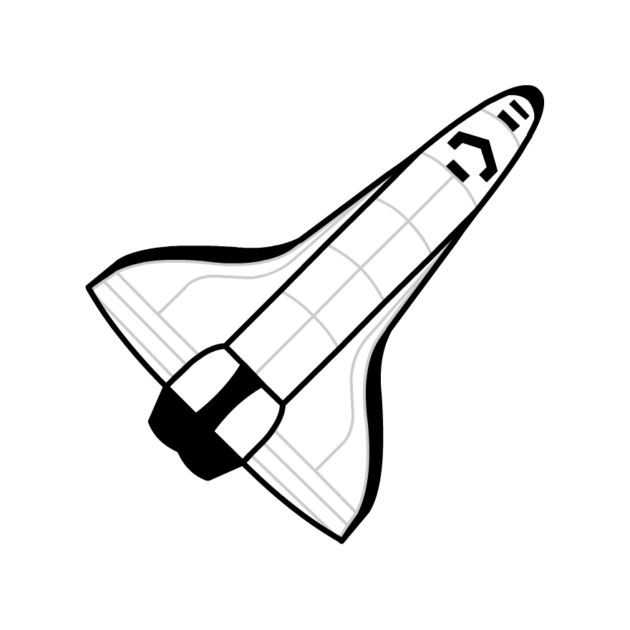


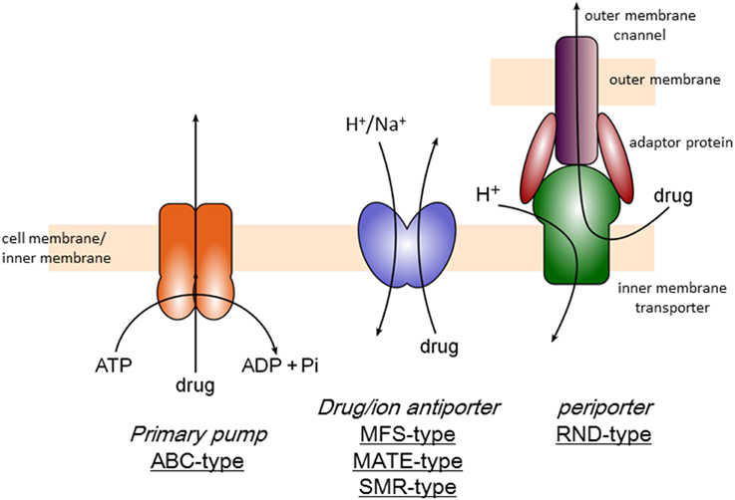
Background
Astronauts have weakened immune system during spaceflight
  Increased possibility for infection
Proton (H+) blocking chemical efflux pumps may cause increased antibiotic resistance
Hypothesize the antibiotic resistance will undergo alteration during low-shear microgravity conditions
Notes:
Astronauts weakened immune response and increased stress factors during prolonged spaceflight render them highly susceptible to bacterial and viral infections in space.
• Pseudomonas aeruginosa PA 01, common pathogen strain of respiratory and urinary tracts infections, grown under high shear normal gravity has shown to have resistance to tigecycline, ciprofloxacin, and aminoglycoside impermeability.
• Microbes can adapt themselves under microgravity conditions by exhibiting greater resistance to stresses such as oxidative, osmolarity, pH, and antibiotic stresses.

Slide 3
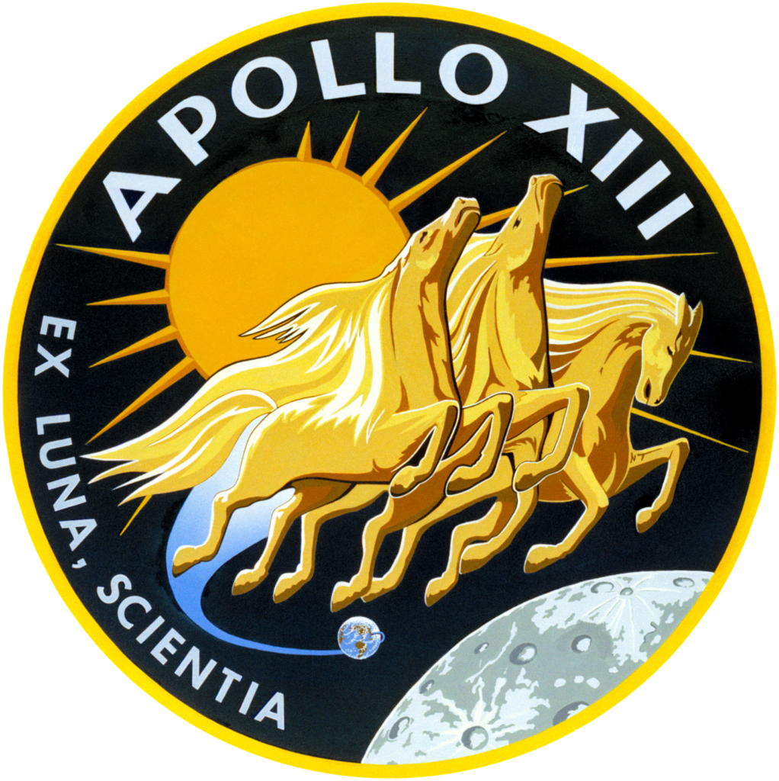
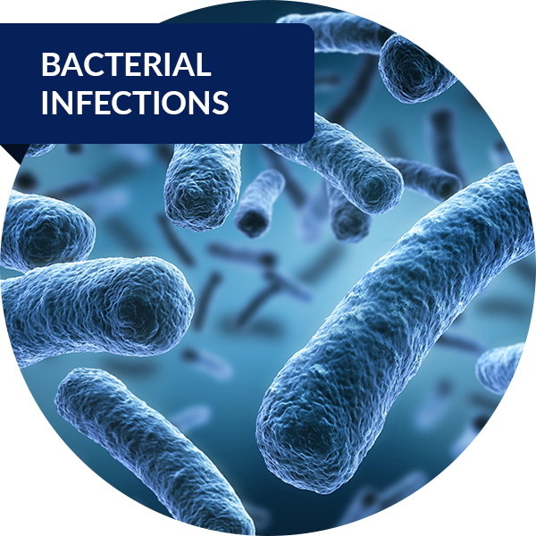
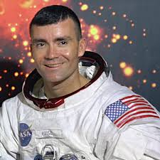
Apollo 13 Astronaut Fred Haise Jr.
Notes:
Astronaut on the 1970 Apollo 13 mission
Contracted infection caused by Pseudomonas aeruginosa causing both a urinary tract and kidney infection
Oxygen tank exploded causing reduction to power, water, and other logistical problems causing the mission to be halted and astronauts to return home.
This infection was probably caused by the reduced water intake, but microgravity and effects of cosmic radiation might have impaired his immune system's reaction to the pathogen.

Slide 4
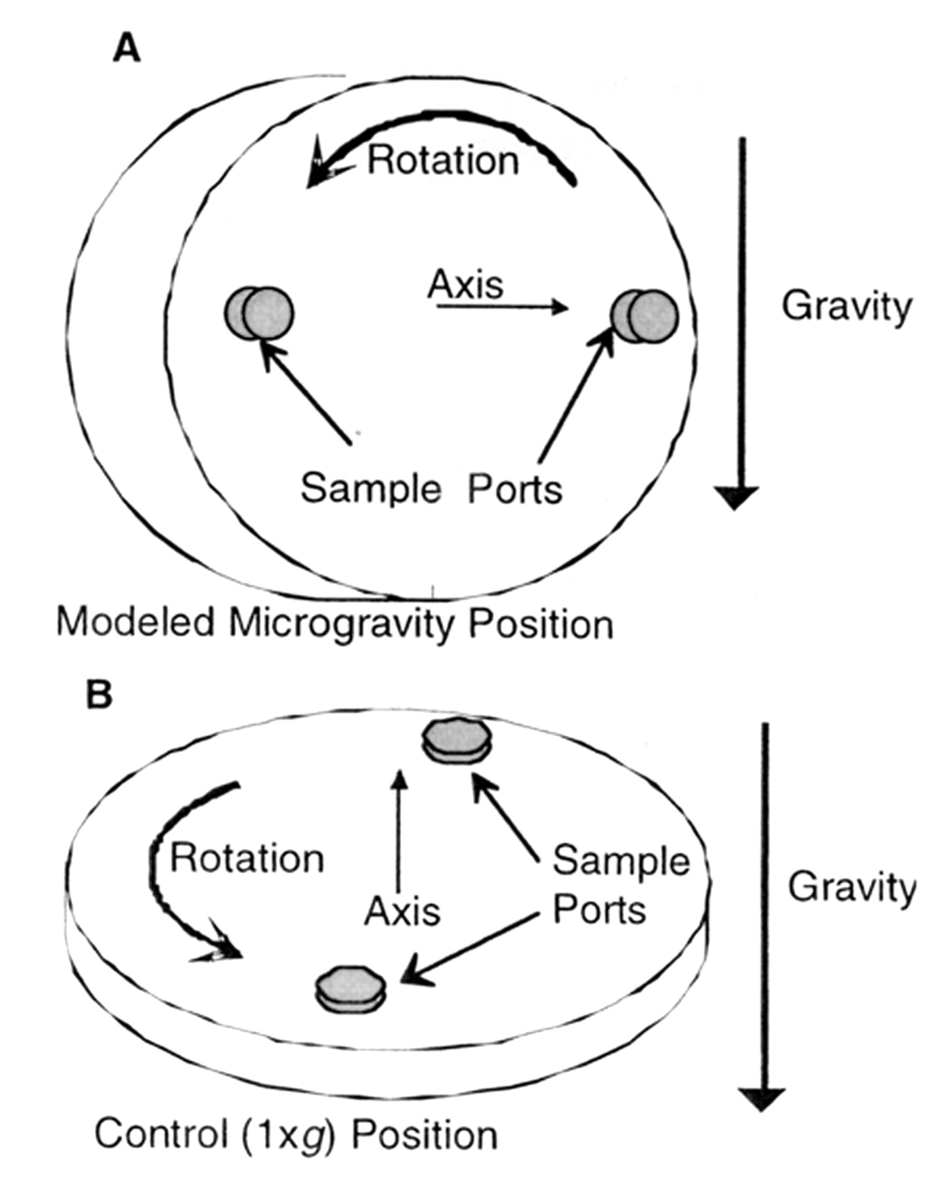
OBJECTIVE
The project will assess the potential acquisition of antibiotic resistance genes in Pseudomonas aeruginosa using the High Aspect Ratio Vessel (HARV) bioreactor, then test against 240 antibiotics and toxic cations/anions using a high-throughput susceptibility framework.

Slide 5
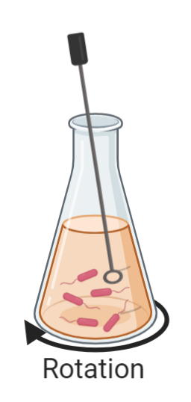
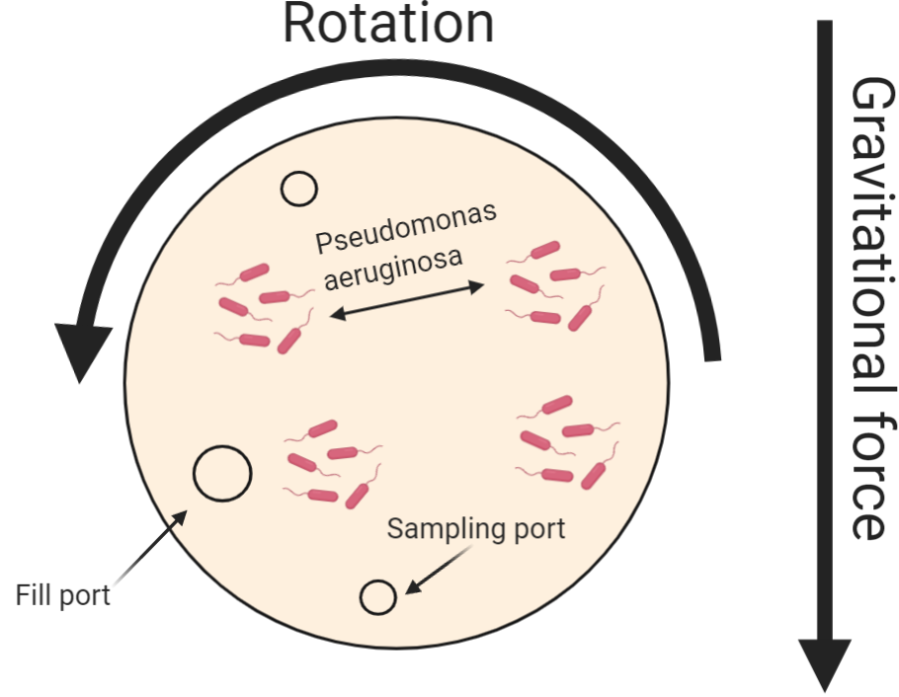
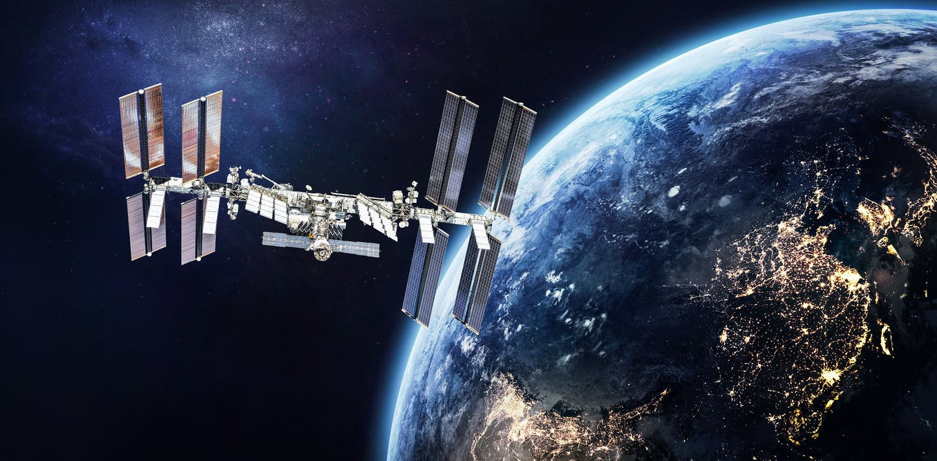
High aspect ratio Vessel to simulate microgravity growth
Velocity Rotation
Gravitational Pull

Slide 6
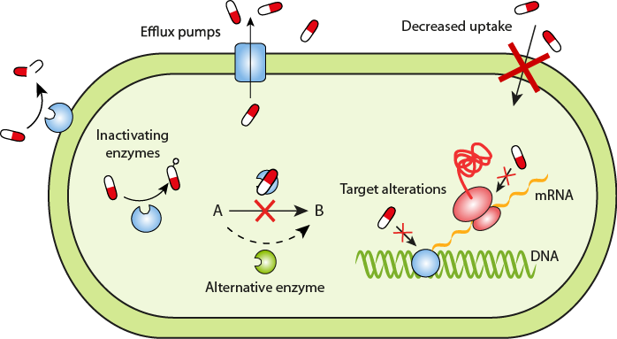
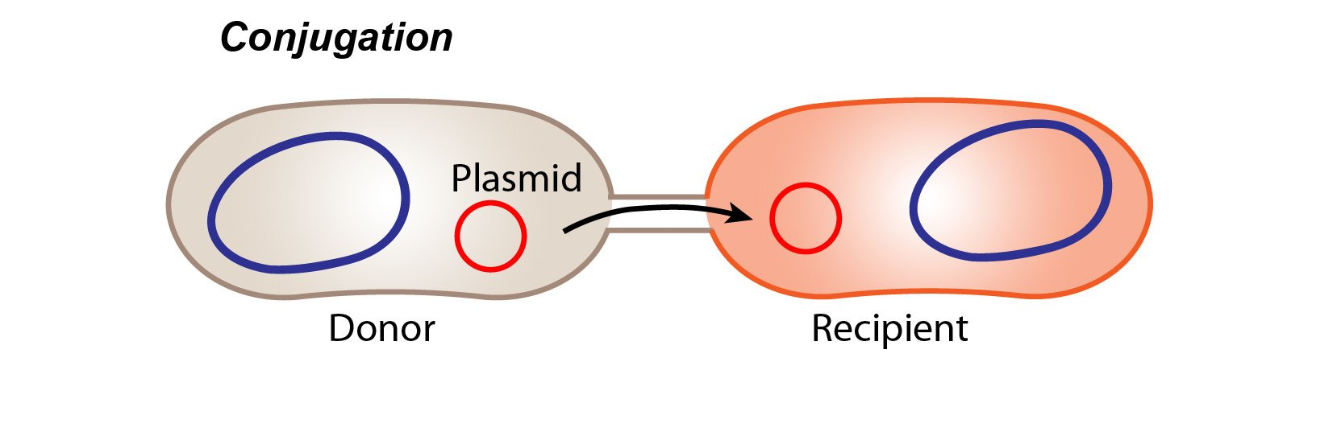
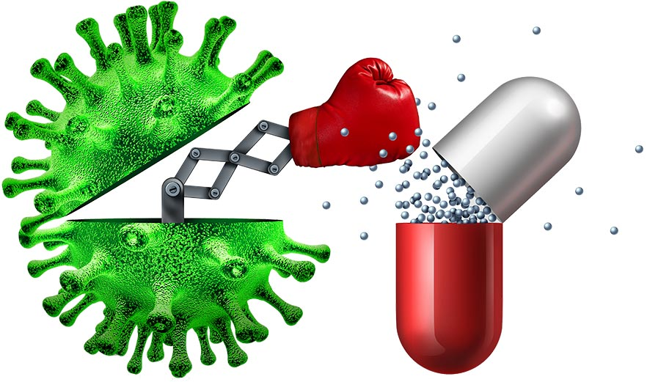
What is antibiotic resistance?
Horizontal Gene Transfer

Slide 7
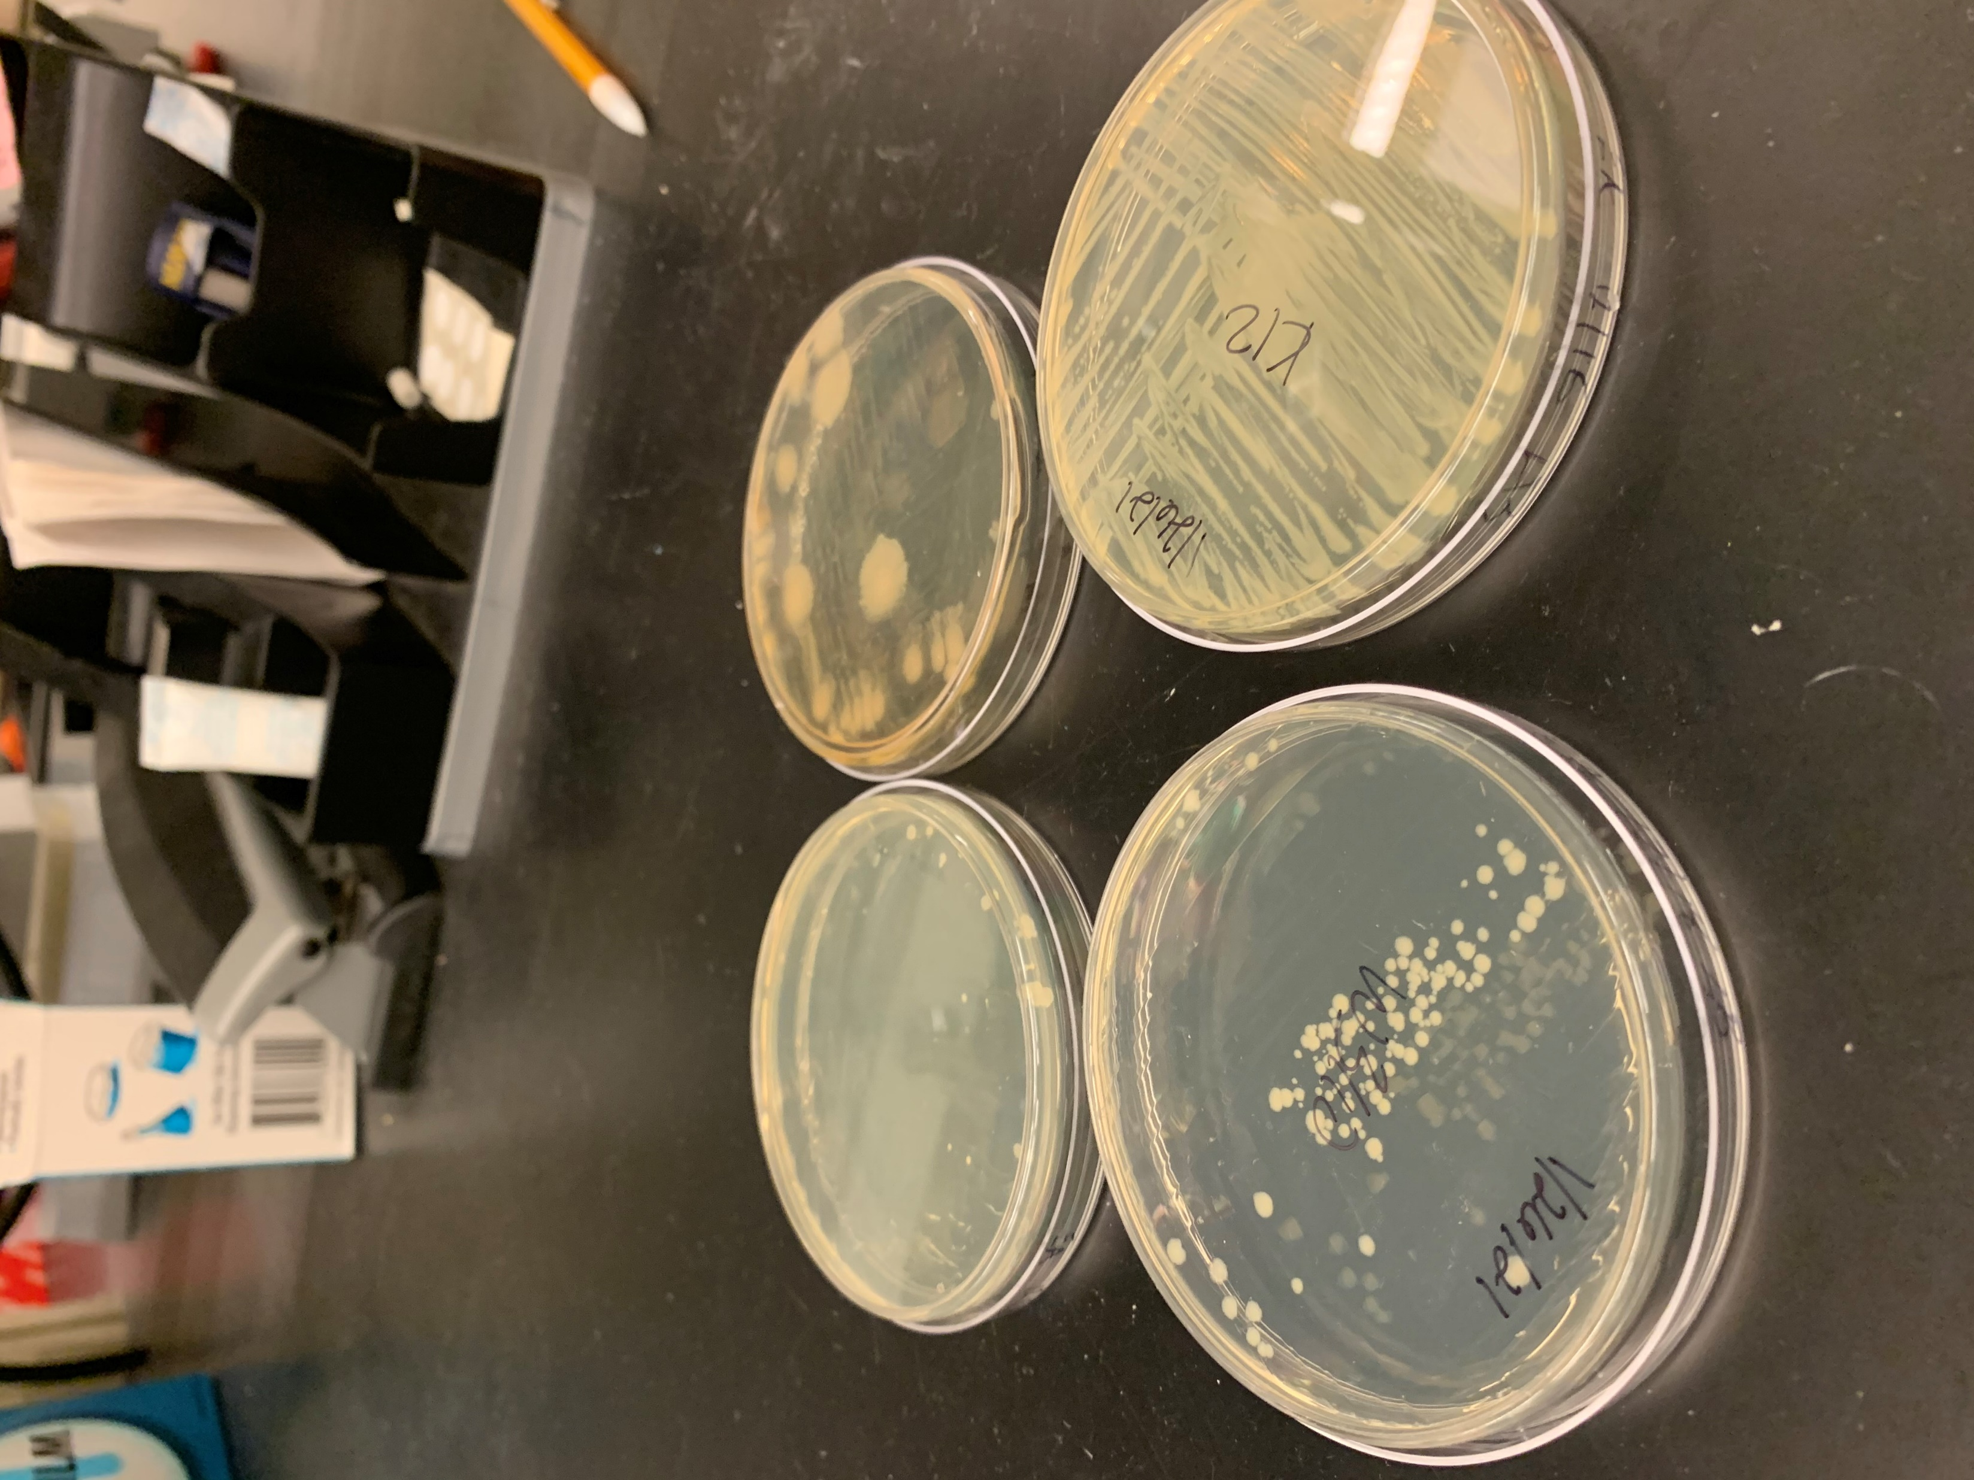
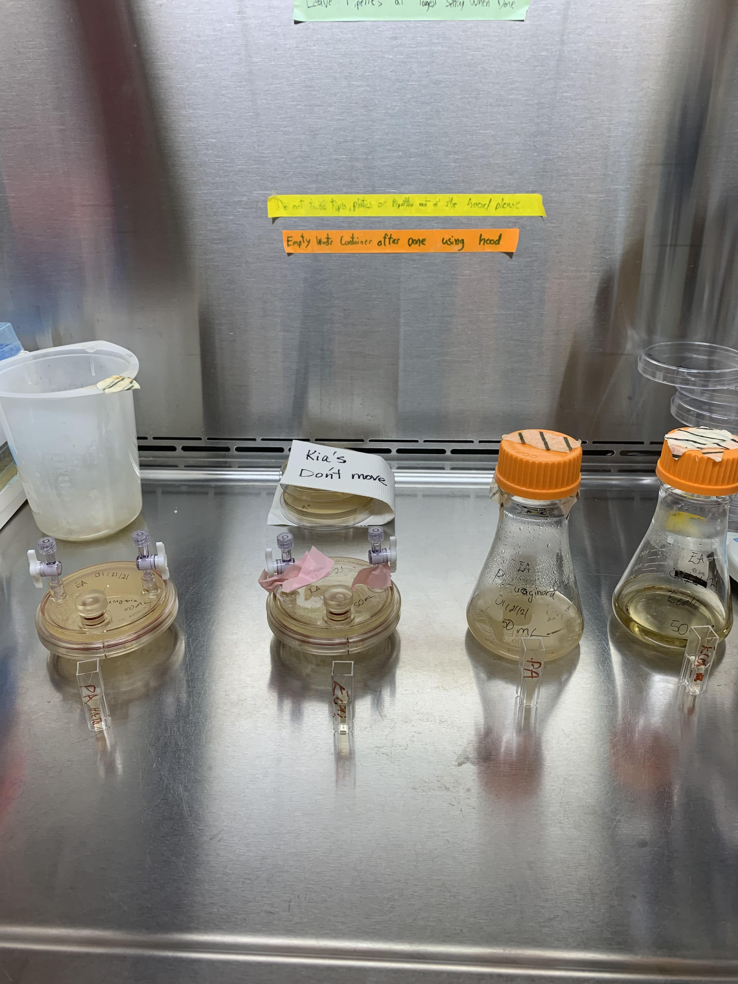
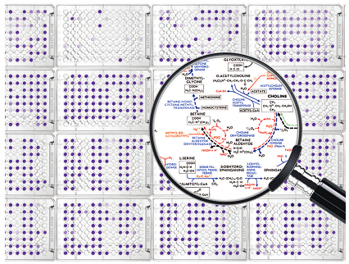

Material and Methods
I.
II.
Pseudomonas and E.coli colonies after streaking methods
Incubation methods at 37ºC
III.
IV.
$$5∗{10}^{4 }cells/mL$$
HARV and flask samples prior to OD₆₀₀ spectrophotometry

Slide 8
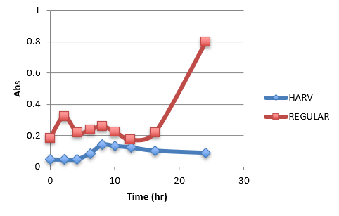
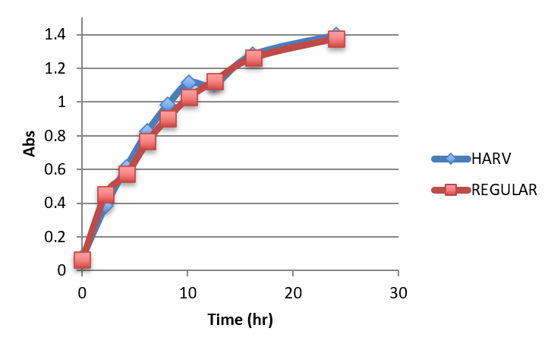
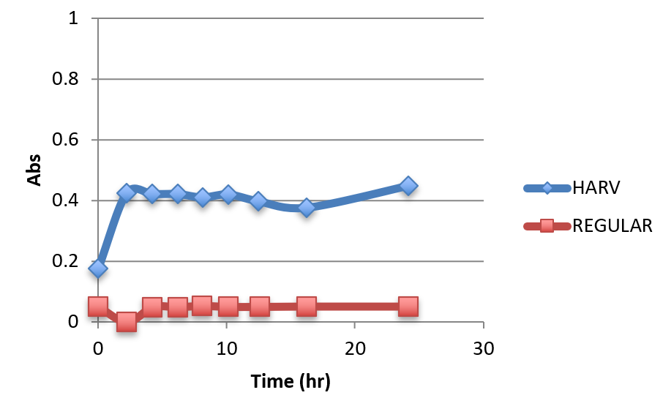
Growth Results
Selected growth curves from 240 chemicals at 4 increasing concentrations
Larger Growth Curve under High Shear Conditions: Piperacillin
No Difference Growth under Both Shear Conditions: Iodonitro Tetrazolium Violet
Larger Growth Curve under Low Shear Conditions: Hexa-chlorophene

Slide 9
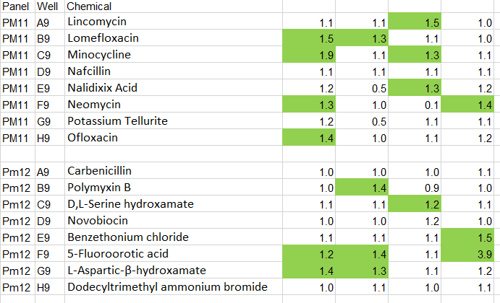
Resistance Results
Selected growth curves from 240 chemicals at four increasing concentrations
Green highlighted cells indicate higher growth and increased resistance to that antibiotic/cation/anion

Slide 10
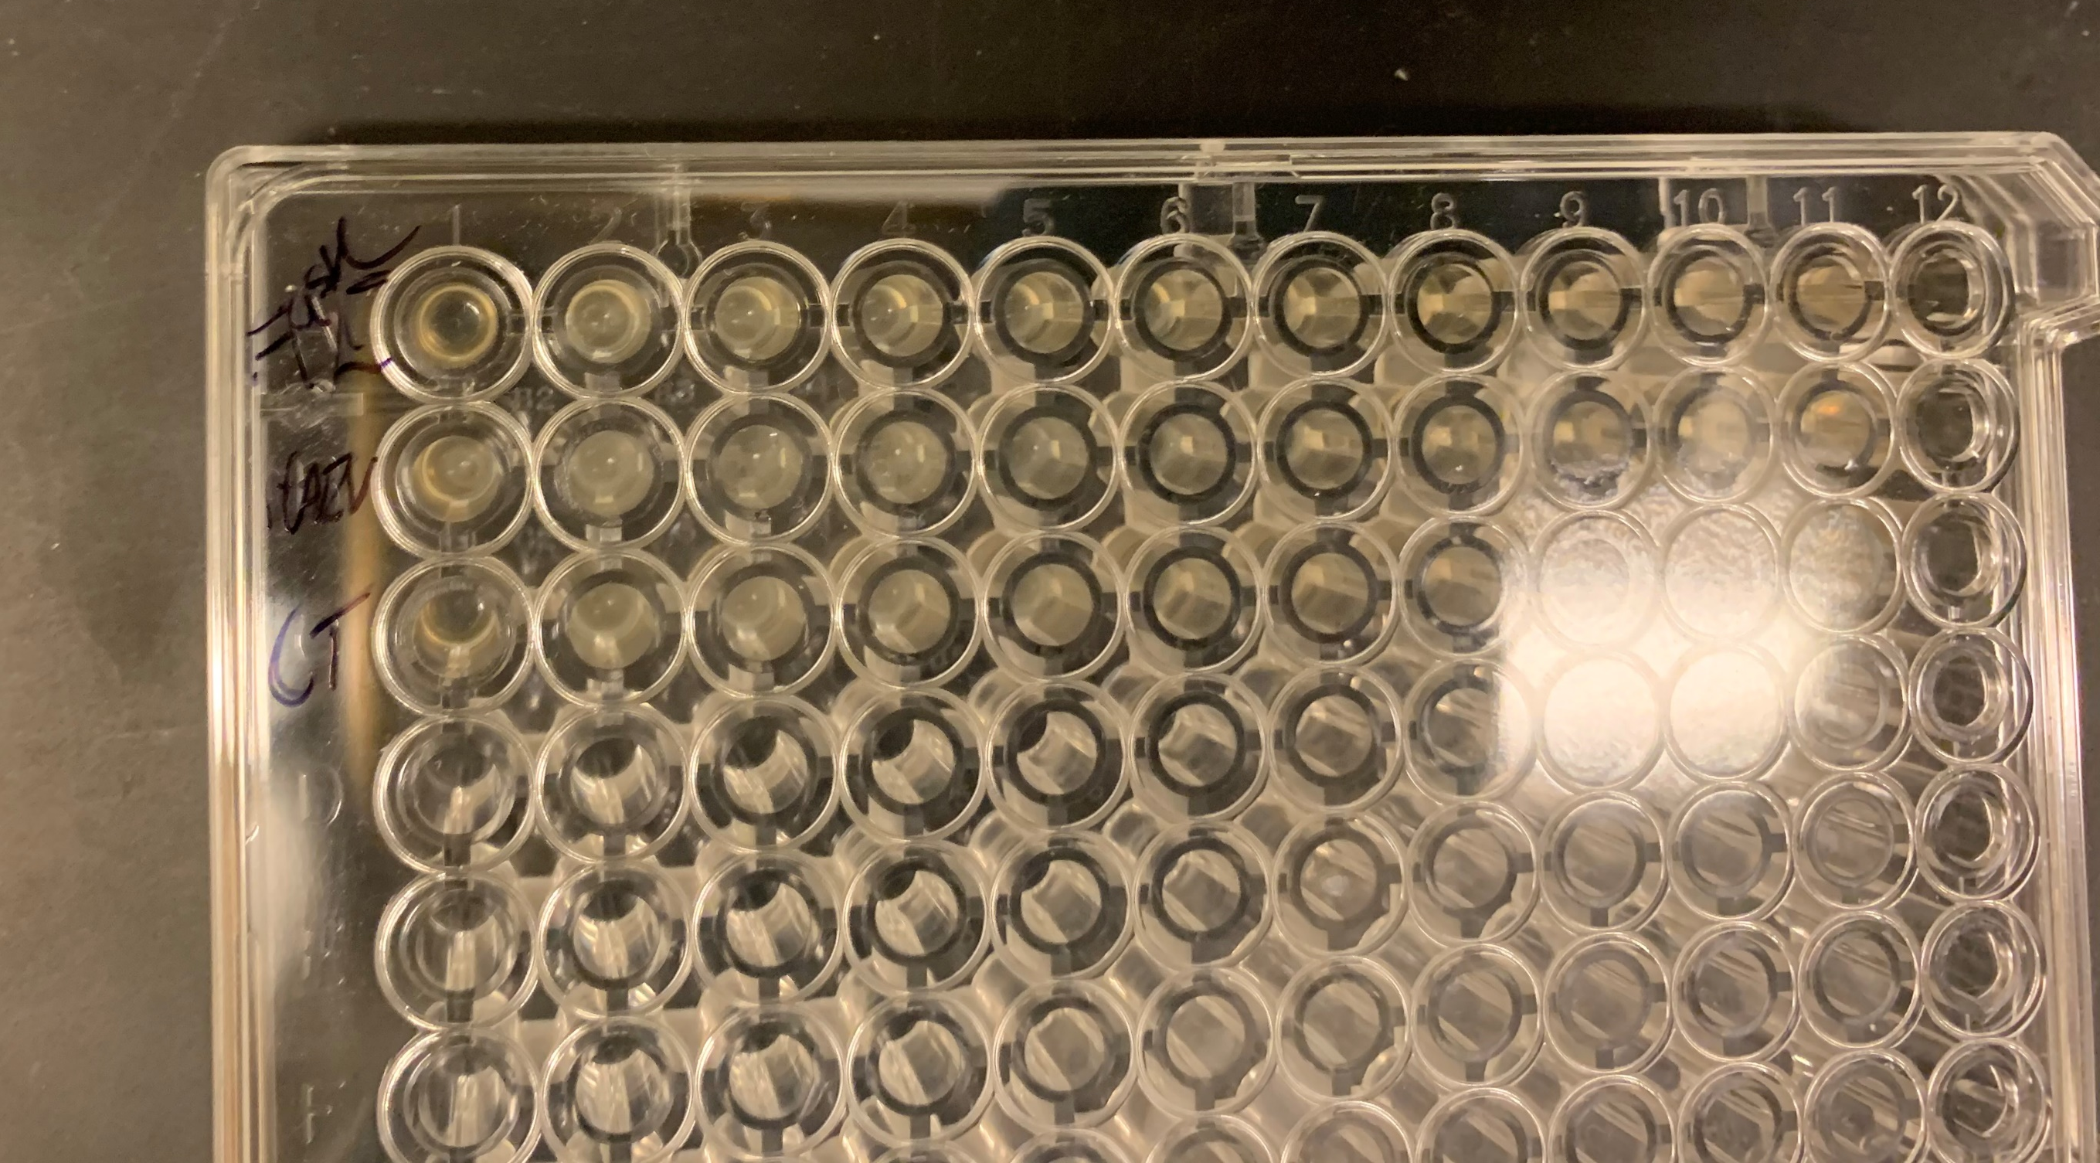
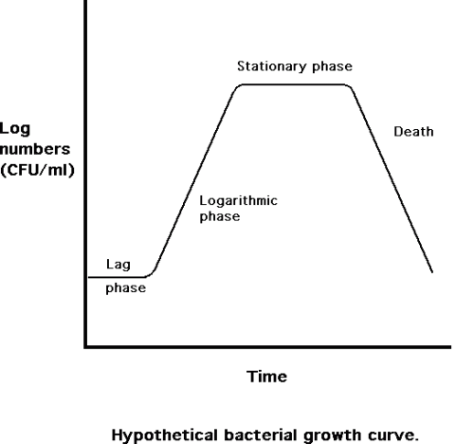
Conclusions
After normalizing the data to mitigate variability and checking for increased resistance
Higher HARV growth in several antibiotics: D-Cycloserine, Glycine hydroxamate, Proflavine
  Disulphiram across all concentrations
Higher Flask growth in Cinnamic acid, 18-Crown- ether, hexa-chlorophene, and
  Phenyl-methyl-sulfonyl-fluoride (PMSF) across all concentrations
HARV is contributing to both growth differences and increased resitance to known antibiotics
MicroAssay plates after 24 growth period

Slide 11
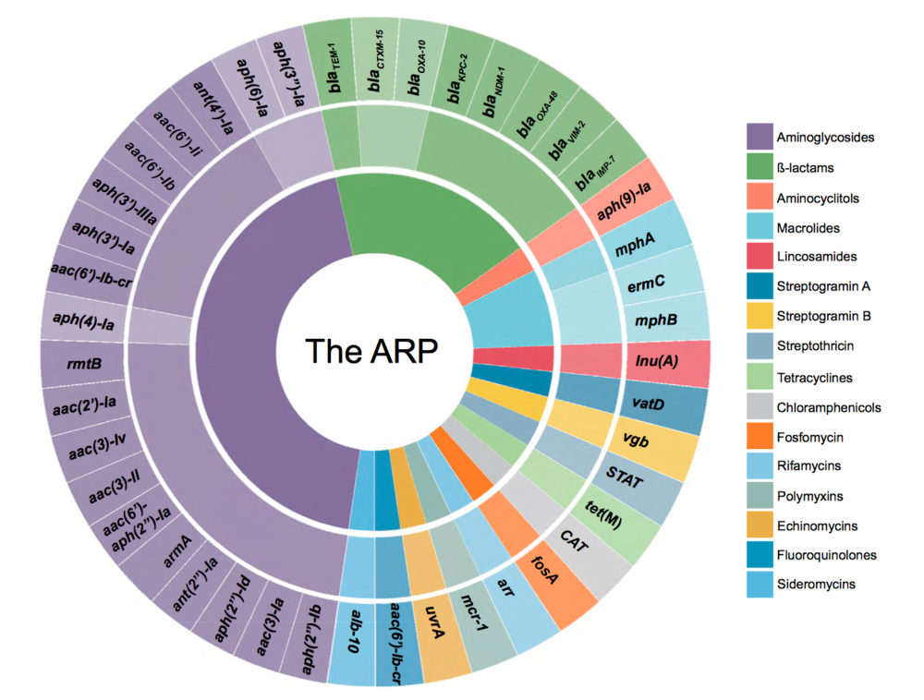
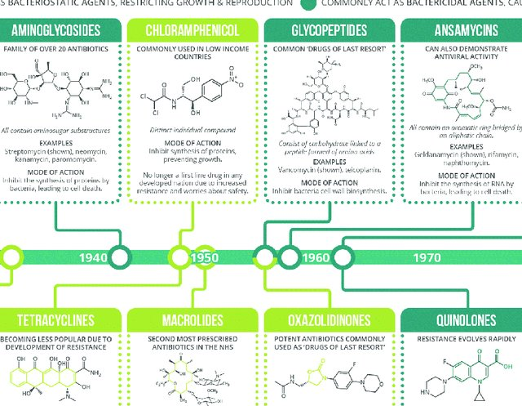
Future Work
Further analysis of abrupt movement to high shear conditions during sampling.
Selective antibiotic testing using data collected from high-throughput methods to better analyze difference in resistance.
Categorize substances by their antibiotic classes or biocides

Slide 12

Acknowledgments and QUESTIONs!
I would like to thank my graduate student mentor, Diego, for teaching me a myriad of lab techniques and being extremely patient with me as I blossomed into an independent student researcher. I would also like to that my PI, Dr. Otakuye Conroy-Ben, for procuring the materials and guiding me on the background knowledge needed for the project as well as supporting me with my post-graduate career. Finally, I would also like to thank the members of the Perreault Lab for being helpful and inviting in our shared lab space. We are thankful for the funding provided by the ASU/NASA Space Grant Program.

Slide 13
References
Orsini, S.S., Lewis, A.M. & Rice, K.C. Investigation of simulated microgravity effects on Streptococcus mutans physiology and global gene expression. npj Microgravity 3, 4 (2017). https://doi.org/10.1038/s41526-016-0006-4
Alcock et al. 2020. CARD 2020: antibiotic resistome surveillance with the Comprehensive Antibiotic Resistance Database. Nucleic Acids Research, 48, D517-D525.
S. V. Lynch, K. Mukundakrishnan, M. R. Benoit, P. S. Ayyaswamy, A. Matin Applied and Environmental Microbiology Dec 2006, 72 (12) 7701-7710; DOI: 10.1128/AEM.01294-06
Kennedy, Ann R. “Biological Effects of Space Radiation and Development of Effective Countermeasures.” Life sciences in space research vol. 1 (2014): 10-43. doi:10.1016/j.lssr.2014.02.004

